Slide 1
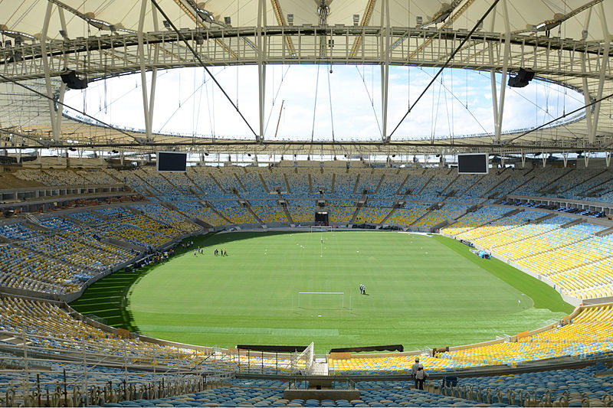
Final
Agile Development Processes
Eric Knauss

Slide 2
“Hi Eric,
Here is the job offering we have now posted externally http://jobs.ericsson.com/job/Ericsson-is-looking-for-the-best-Software-and-Hardware-Developers-in-the-industry%21/61675600/
Also a couple of your students discussed that they were interested in thesis work in "organization transformation".
Please remind them to post it to my and mats if they had come up with an idea of how they would like to do that.
Cheers,
Jonas”

Slide 3
Schedule
Håkan Burden: Combining Model-Driven Engineering and Agile Development, 2014, burden@cse.gu.se
Paryia Kashfi: UX and Agile, 2014, pariya.kashfi@chalmers.se
Nelson Sekitoleko, Felix Evbota et al.:Technical Dependency Challenges in Large-Scale Agile Software Development. In Proc. of Int’l Conf on Agile Software Development, (XP ‘14), pages 46-61, Rome, Italy, 2014.
Awards

Slide 4
5

Slide 5
1

Slide 6
0

Slide 7
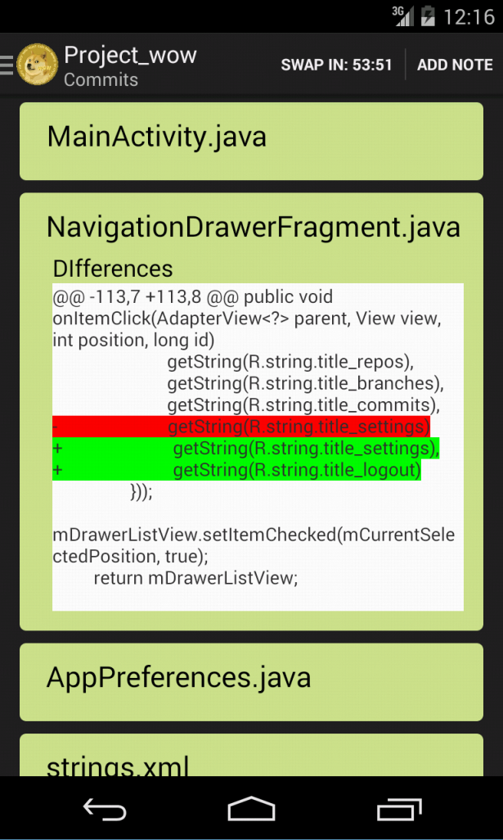
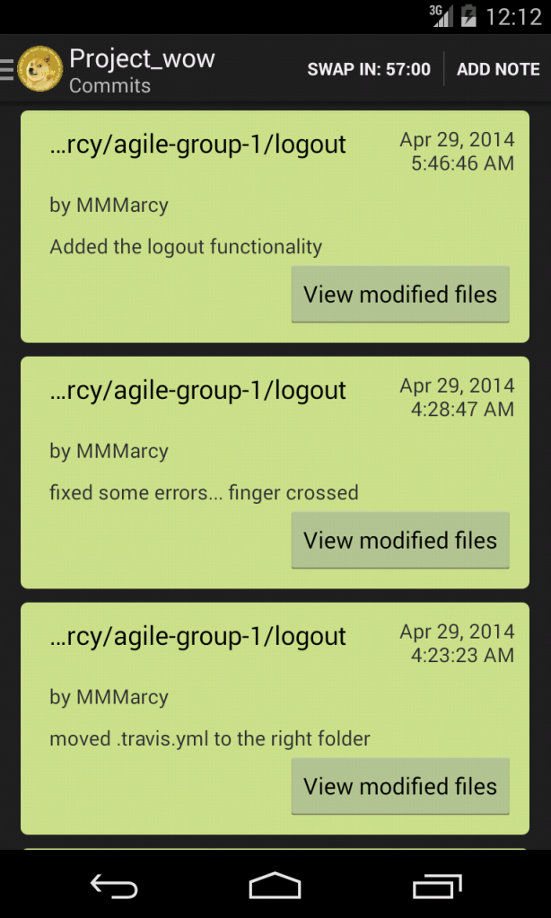
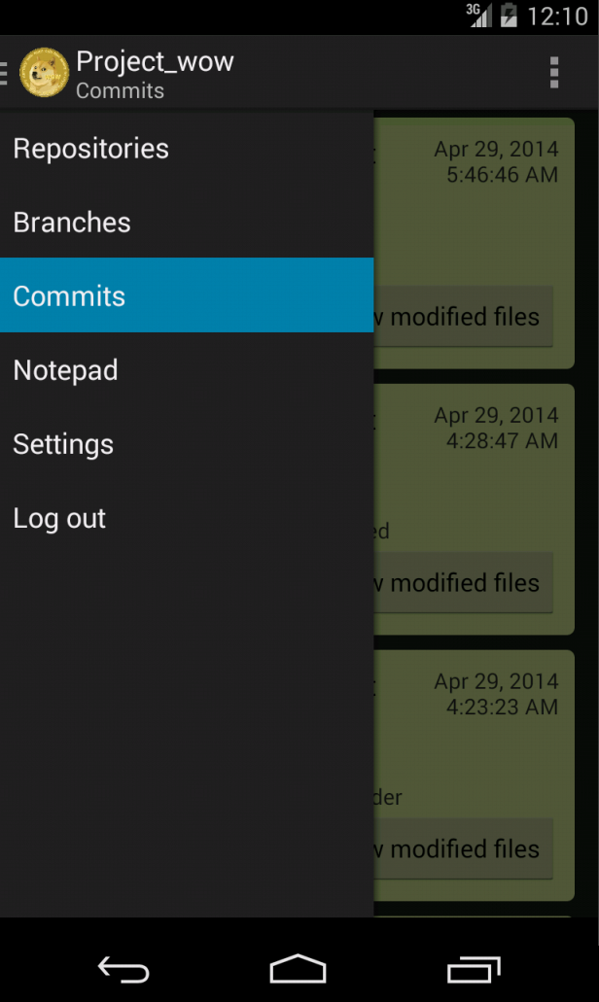
Group 1
Award
Most advanced file diff functionality
Notes:
Motivation: The application was able to show what files had been changed but also what lines in the files that had been changed using red/green coloring for added/removed lines of code. In addition this functionality was implemented without taking to much screen real-estate.

Slide 8
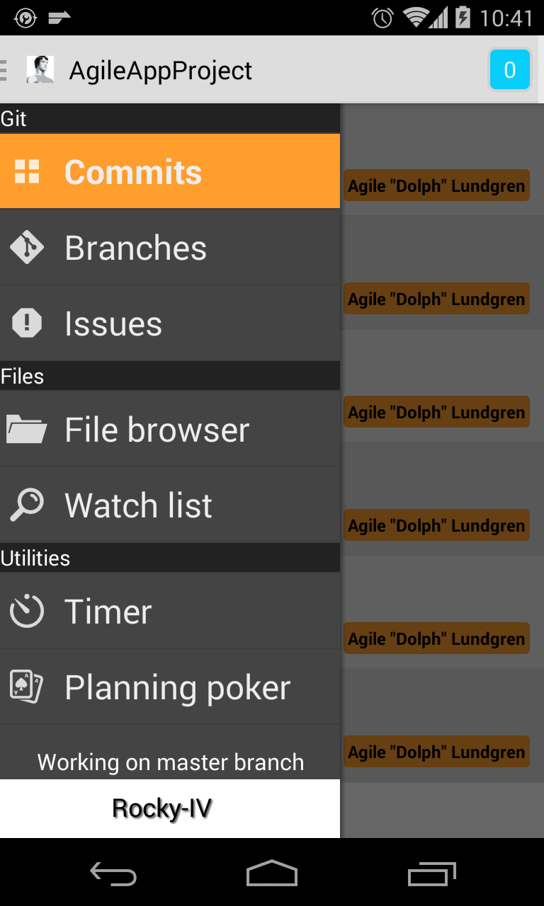
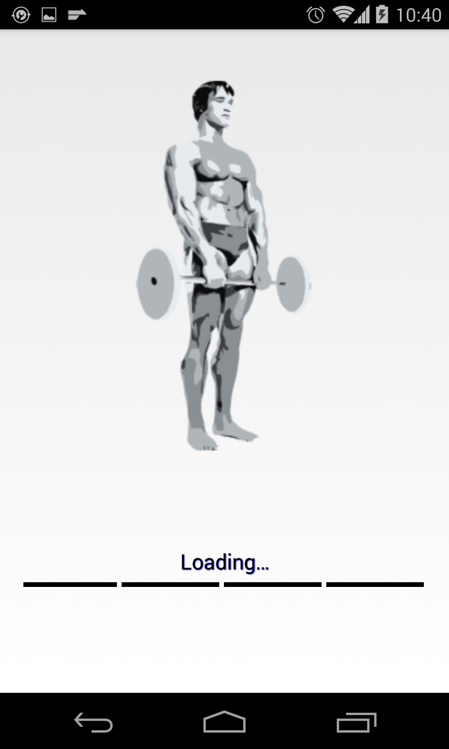
Group 2
Award
Best notification management in an App
Notes:
Motivation: The app stored all notifications in a popup window in the app that made them easily accessible to the user for management.

Slide 9
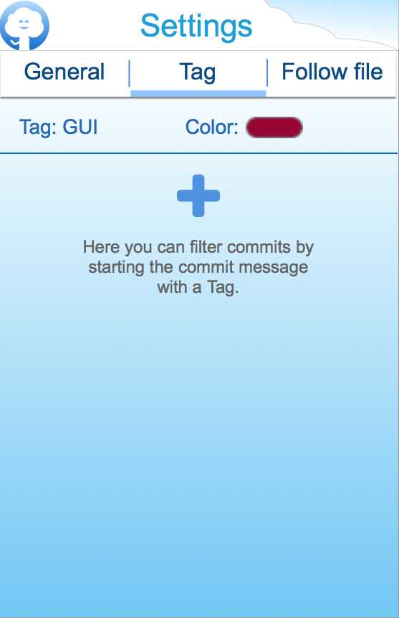
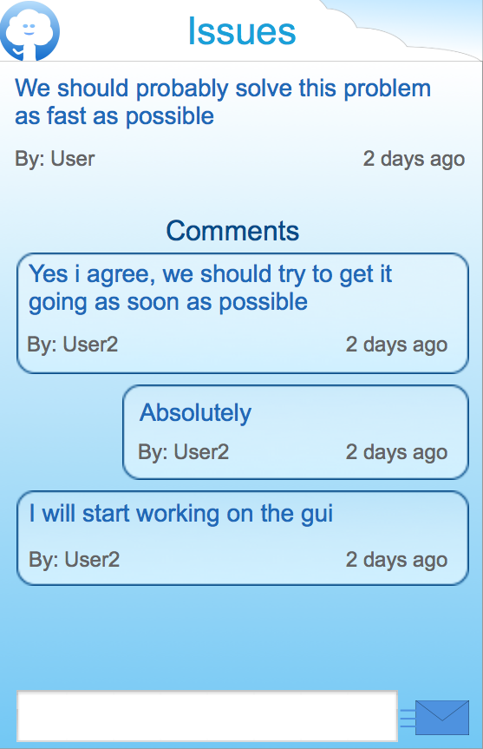
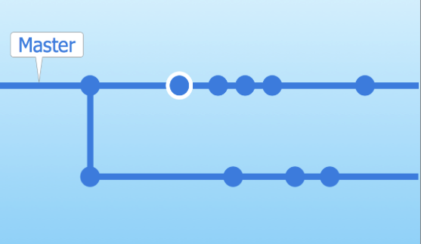
Group 3
Award
Most User Experience focus App.
Notes:
Motivation: Significant focus was placed on the user experience of the app, with clear and acceptance tested prototypes resulting in a clear and usable application GUI.

Slide 10
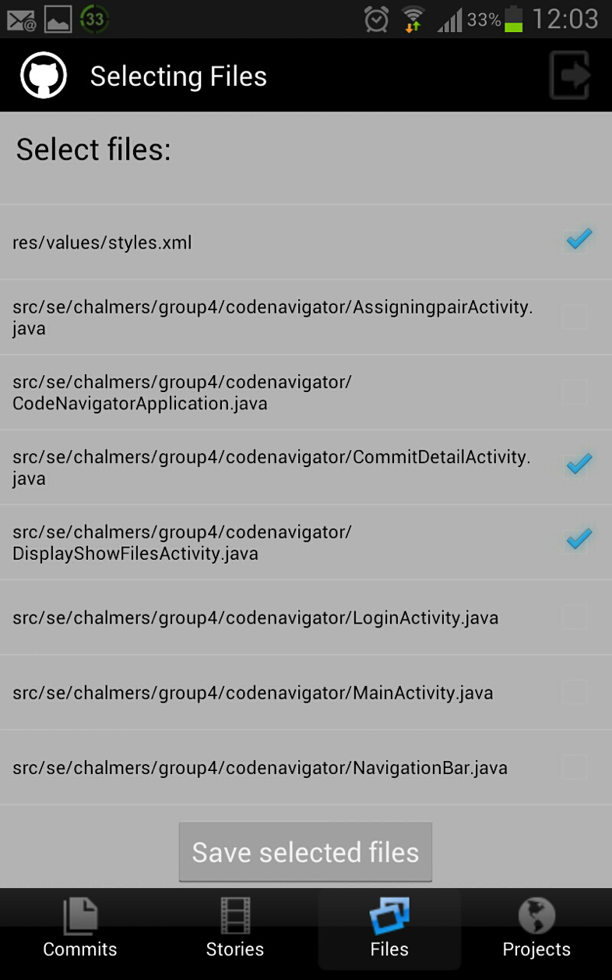
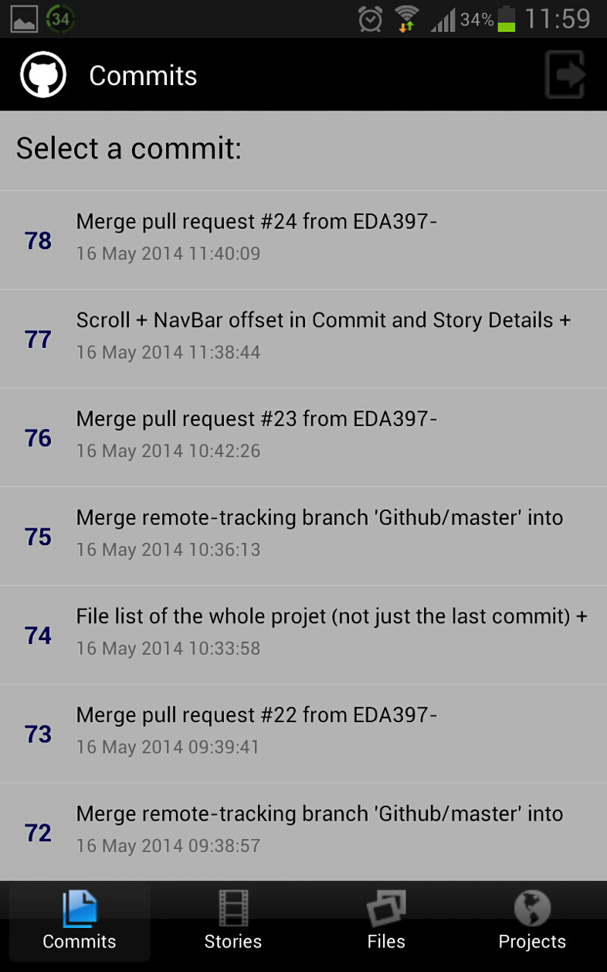
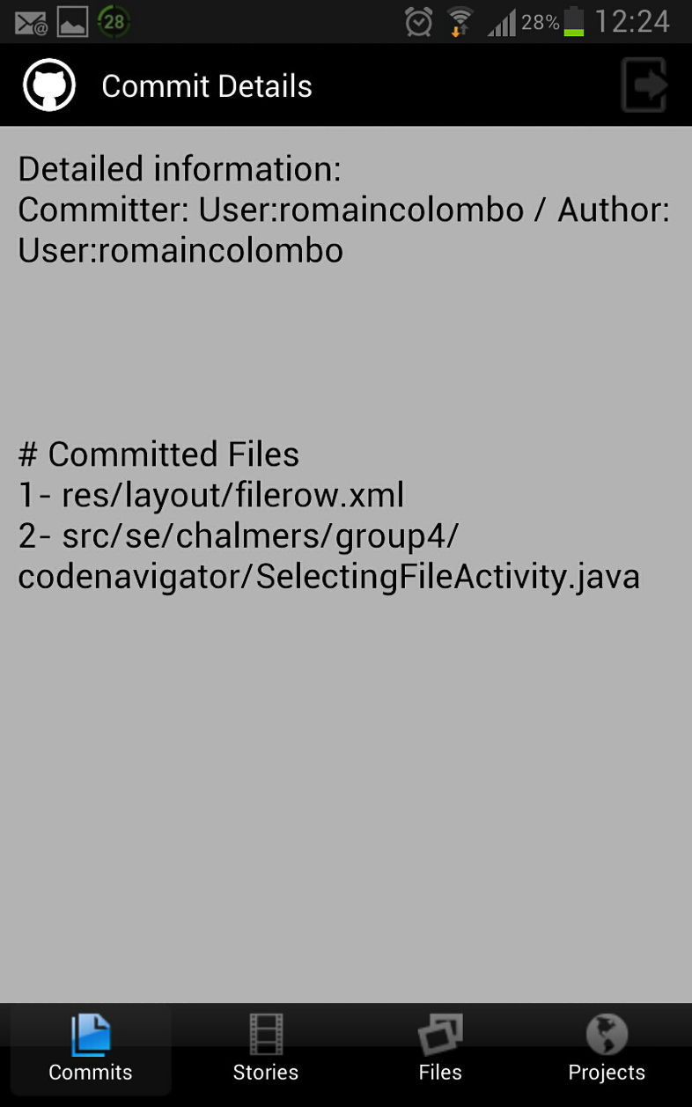
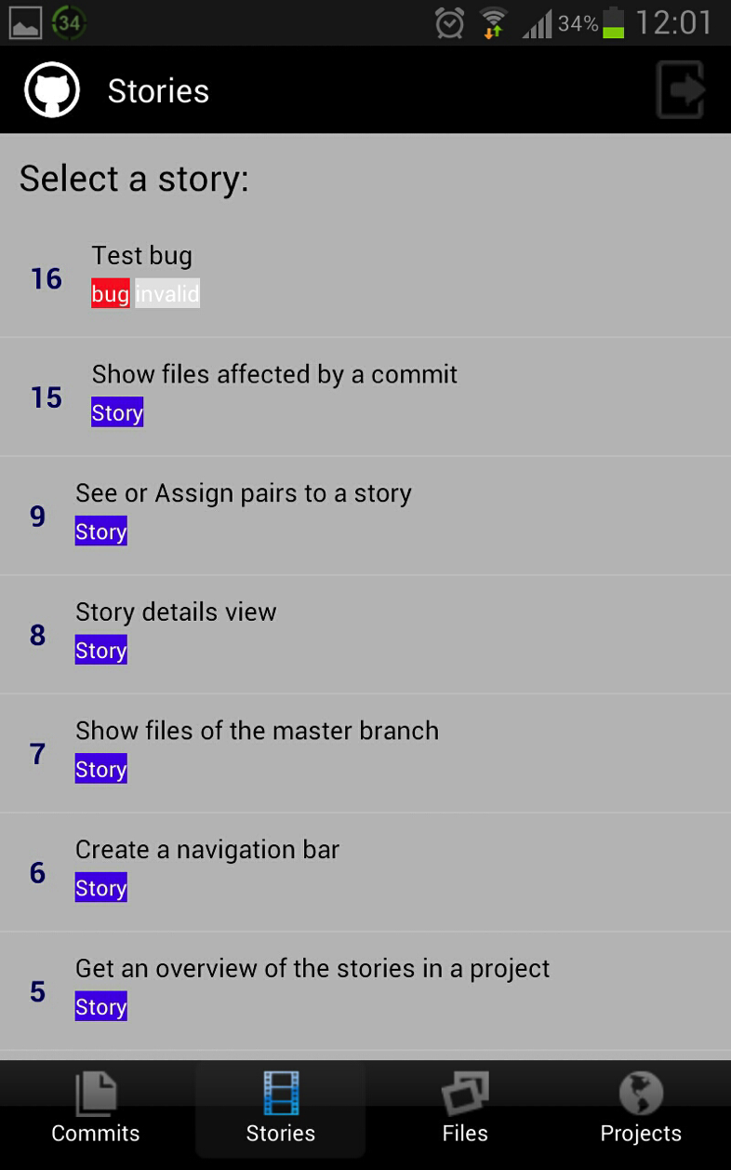
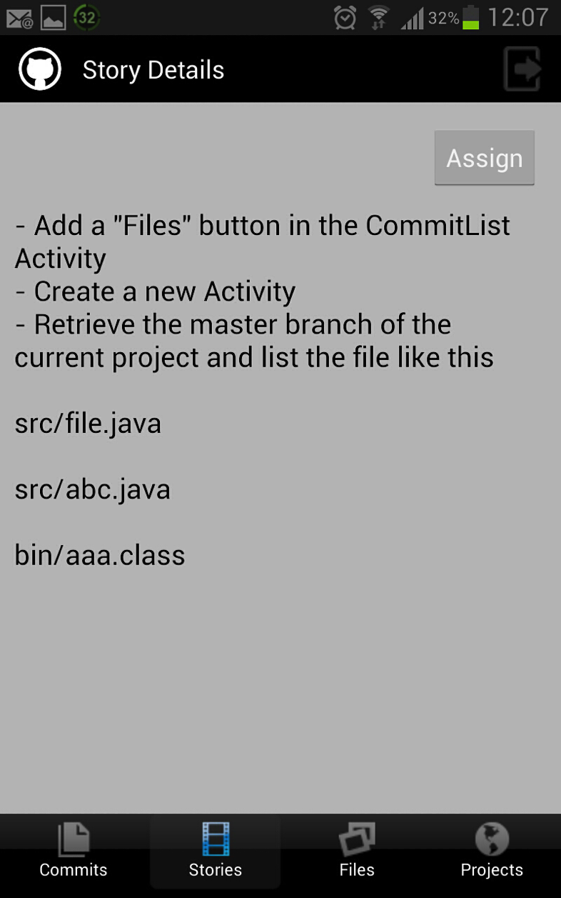
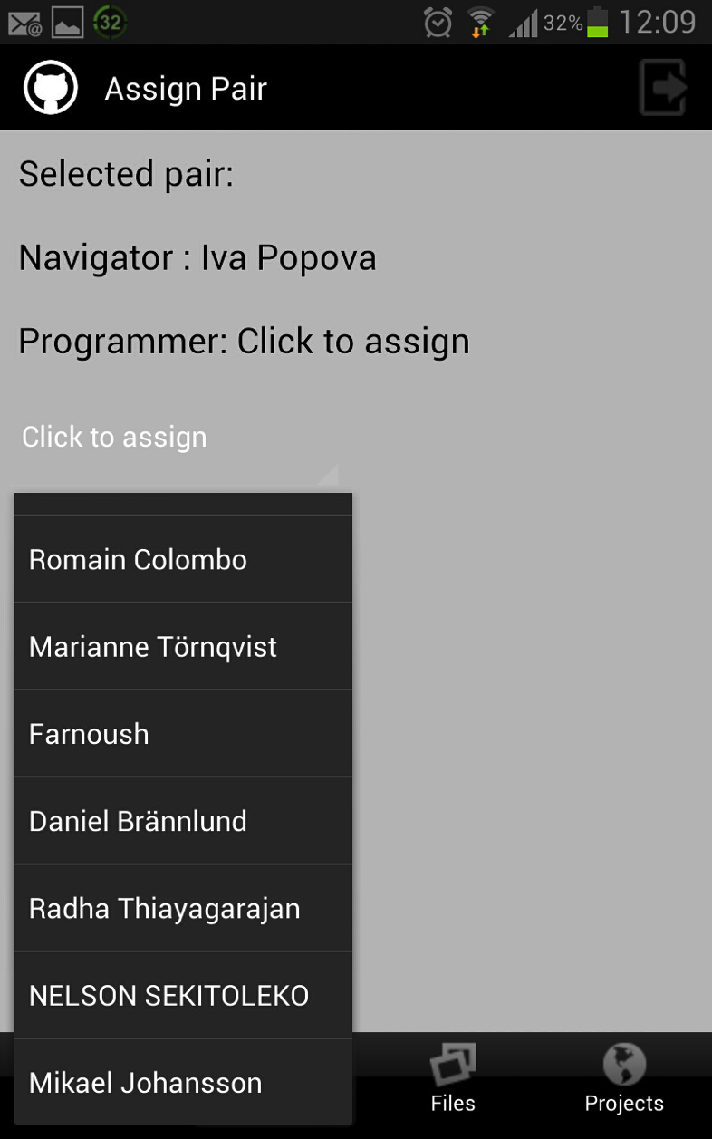
Group 4
Award
Smoothest look and feel with loading screens in an App
Notes:
Motivation: What the app lacked in functionality it made up in sleekness. Traversing the screens of the app was clear and smooth with loading screens added in an impressive way to optimize user experience.

Slide 11
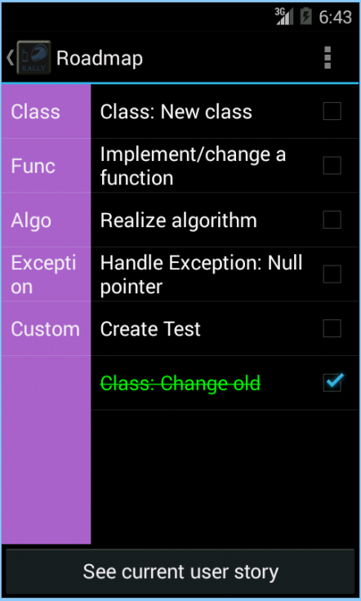
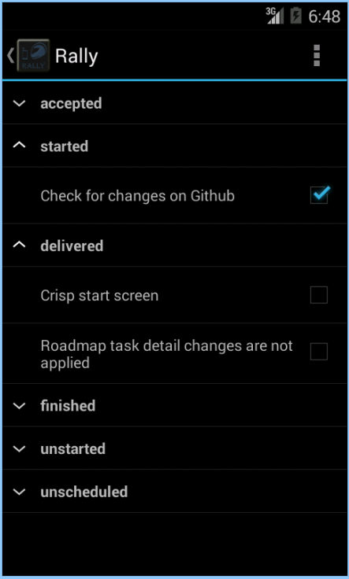
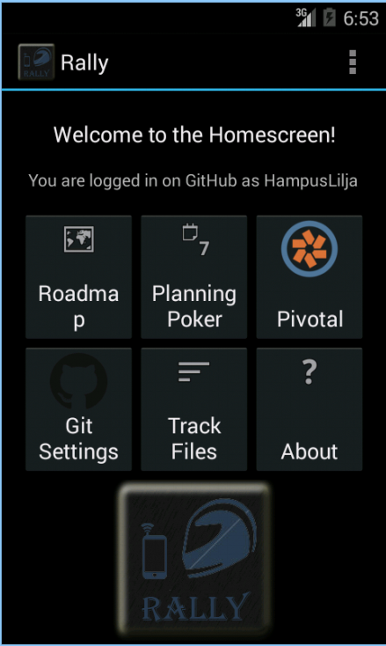
Group 5
Award
Most functionality award for an App
Notes:
AWARD: Best startscreen award for an App
Motivation: The apps startscreen made it very easy for the user to start using the functionality, which was plenty, in the app. Thus making navigation simple and clear to the user.
AWARD: Most functionality award for an App
Motivation: Github, planning poker, pivotal tracker, blinking leds for notifications, automated logins, and more! The app had it all, even though some of the functionality was not as developed as it could have been.
AWARD: Best roadmap functionality for an App
Motivation: The app made the text of the feature that the user was working with easily accessible and allowed for macro creation and usage in a way that was clearly designed with the user in mind, making it very usable.

Slide 12
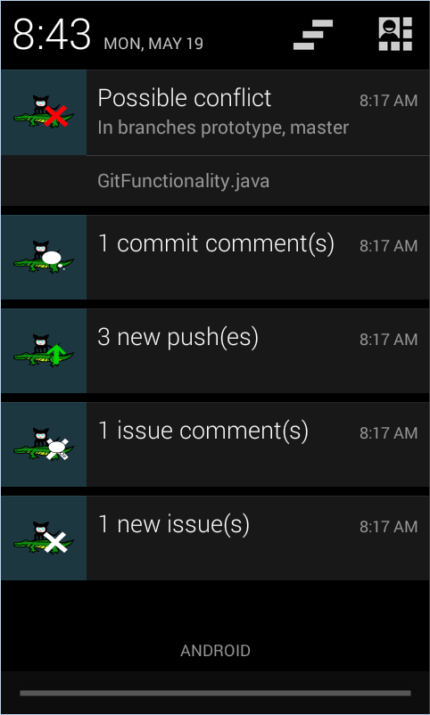
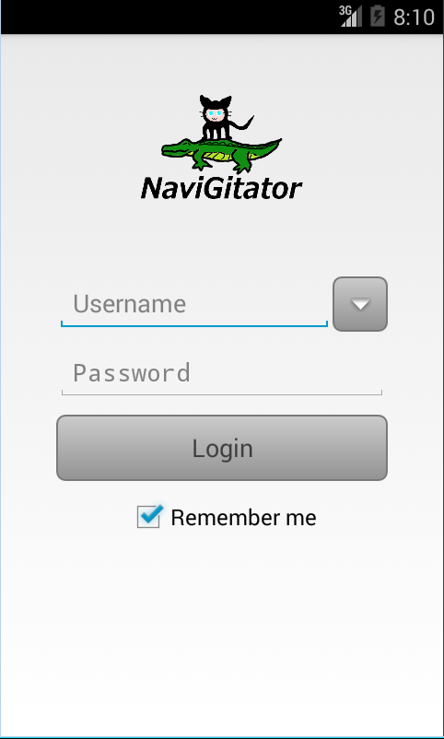
Group 6
Award
Best notification scheme in an App
Notes:
Motivation: App made it able for a user to follow many different branches at once and clearly indicating if several branches updated the same files for enhanced usability.

Slide 13
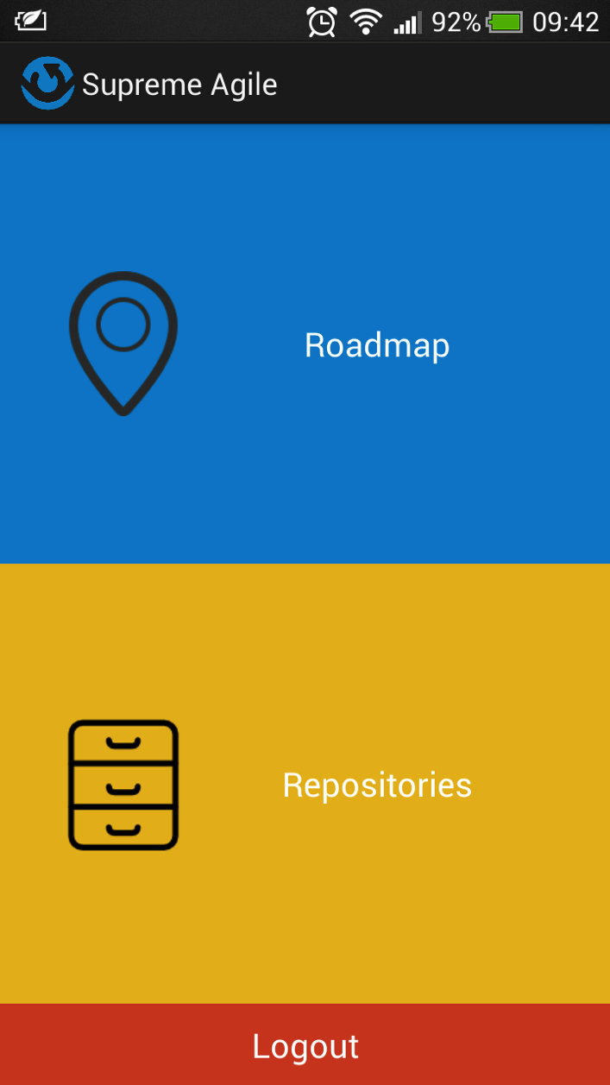
Group 7
Award
Best pivotal tracker integration in the roadmap
Notes:
Group 7:
AWARD: Most pivotal tracker integration in the roadmap Award
Motivation: The app posted all tasks from the tasks in a roadmap as tasks in pivotal tracker, making them accessible to all the team members and made it possible for everyone to follow the progress of a feature.
AWARD: Most advanced roadmap functionality Award
Motivation: The integration with pivotal tracker made the roadmap implementation dynamic and distributed in a way that was still easily usable by the navigator. Thus, complex functionality made easy.

Slide 14
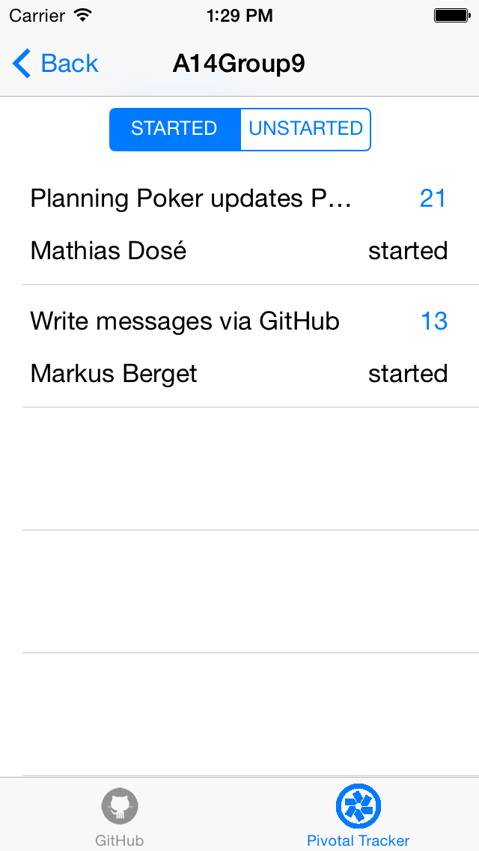
Group 9
Award
Best iPhone App
Most usable planning poker sub.app Award
Notes:
AWARD: Best iPhone App AWARD
Motivation: Only iPhone App ;)
AWARD: Most usable planning poker sub.app Award
Motivation: The planning poker was connected to pivotal tracker, making it usable in the sense that estimates could be set directly from the app. Thus, making it the most usable planning poker app.

Slide 15
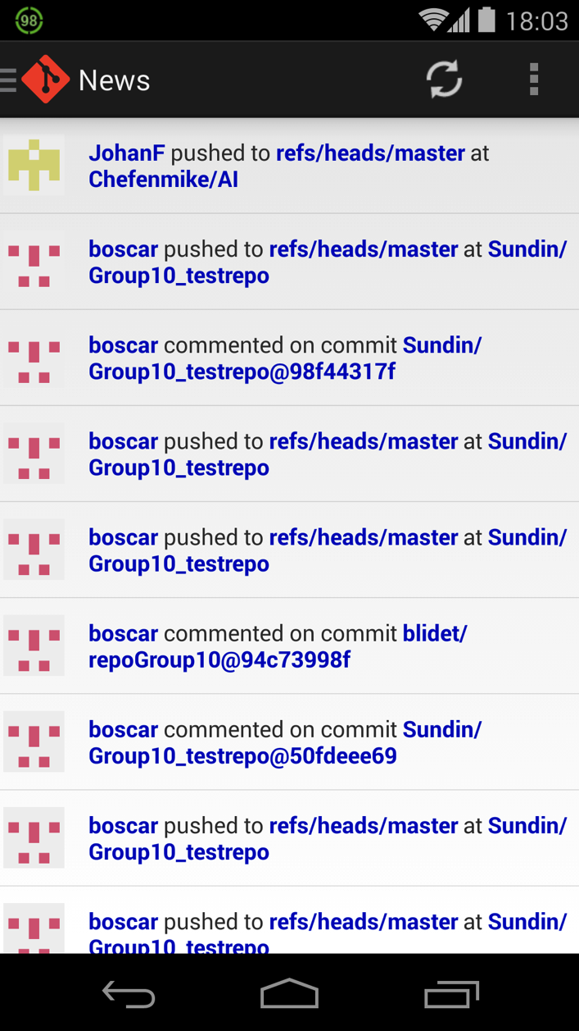
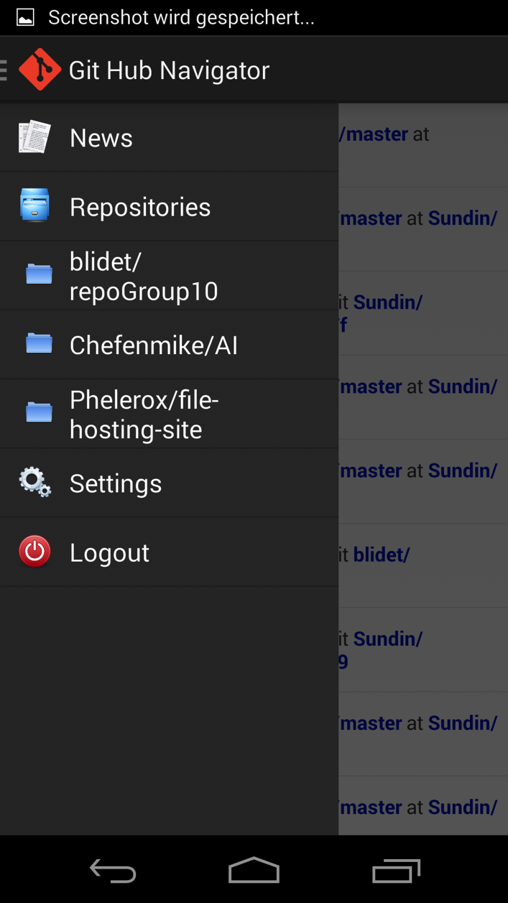
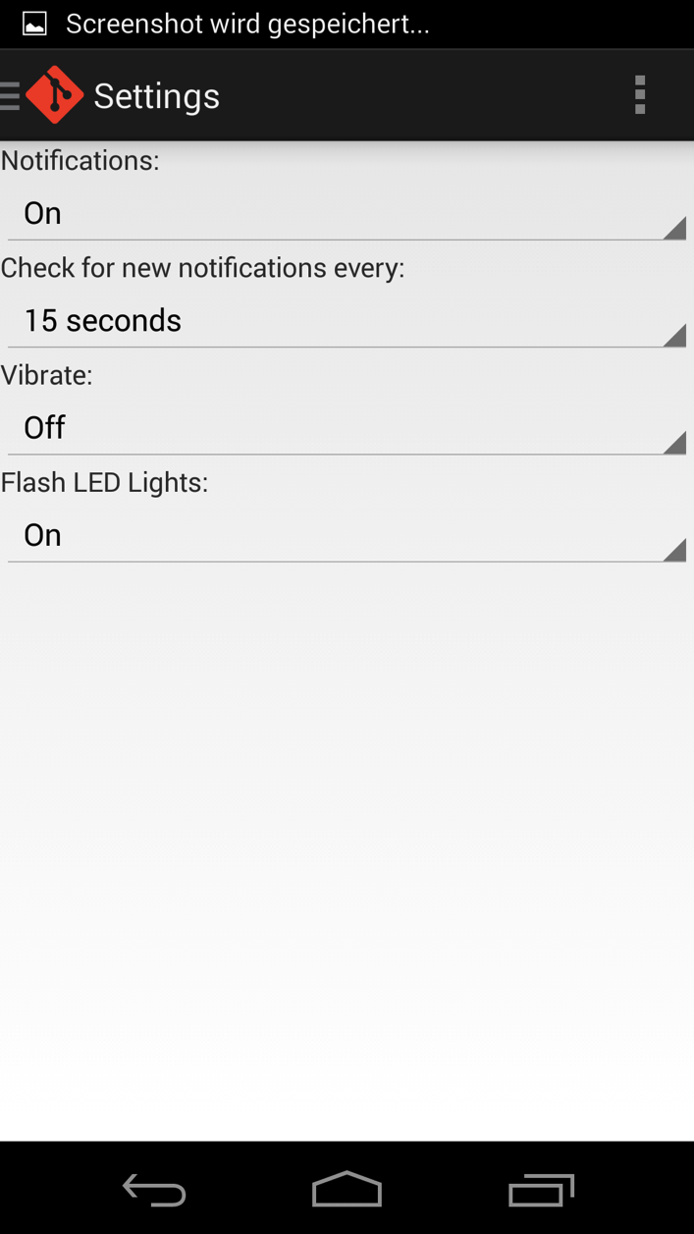
Group 10
Award
Most applicable/usable app award
Notes:
AWARD: Most applicable/usable app award
Motivation: The app displayed conflicts, commits and comments with the led light on the android phone, which made it very discrete but clearly visible to the navigator. In addition, the information presentation in the app had high performance and displayed large amounts and the right information to the user in a clear way.
AWARD: Best notification indication in an app award
Motivation: The led notification was implemented in a good way with good usage scenarios for each color. In addition, the text notification were colorcoded in the same way as the led, making the app intuitive and easy to use.

